Slide 1
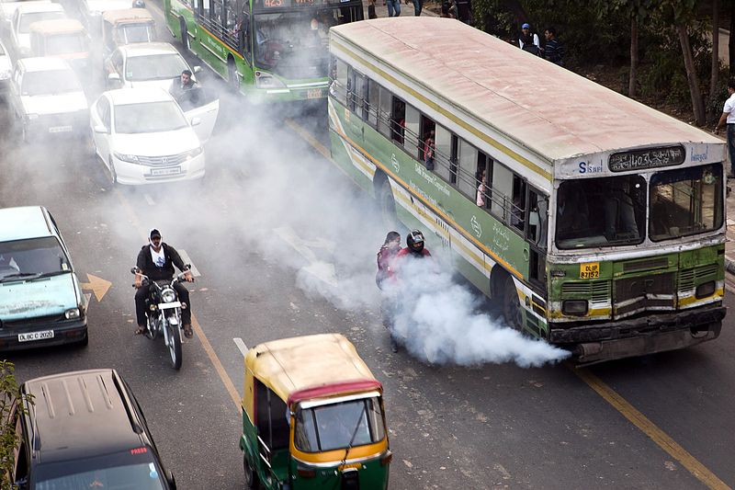
A Machine Learning Model for Average Fuel Consumption in Heavy Vehicles

Slide 2
ABSTRACT
data summarization approach based on distance rather than the traditional time period when developing individualized machine learning models for fuel consumption.
This approach is used in conjunction with seven predictors derived from vehicle speed and road grade to produce a highly predictive neural network model for average fuel consumption in heavy vehicles.
The proposed model can easily be developed and deployed for each individual vehicle in a fleet in order to optimize fuel consumption over the entire fleet.
The predictors of the model are aggregated over fixed window sizes of distance traveled.
Different window sizes are evaluated and the results show that a 1 km window is able to predict fuel consumption with a 0.91 coefficient of determination and mean absolute peak-to-peak percent error less than 4% for routes that include both city and highway duty cycle segments.

Slide 3
INTRODUCTION
FUEL consumption models for vehicles are of interest to manufacturers, regulators, and consumers. They are needed across all the phases of the vehicle life-cycle.
In this paper, we focus on modelling average fuel consumption for heavy vehicles during the operation and maintenance phase. In general, techniques used to develop models for fuel consumption fall under three main categories:
Physics-based models:-which are derived from an in-depth understanding of the physical system. These models describe the dynamics of the components of the vehicle
Machine learning models:- which are data-driven and represent an abstract mapping from an input space consisting of a selected set of predictors to an output space that represents the target output.
Statistical models:- which are also data-driven and establish a mapping between the probability distribution of a selected set of predictors and the target outcome a model that can be easily developed for individual heavy vehicles in a large fleet is proposed.

Slide 4
LITERATURE REVIEW
Li et al. published "A comparative study of machine learning methods for predicting fuel consumption of heavy-duty vehicles." The performance of various machine learning algorithms (e.g., support vector regression, random forests, and artificial neural networks) in predicting fuel consumption in heavy-duty vehicles is compared in this paper. According to the results, random forests and artificial neural networks performed the best.
Mohammadi an et al. published "Predictive modelling of fuel consumption in heavy-duty vehicles using machine learning techniques." This paper presents a model for predicting fuel consumption in heavy-duty vehicles that employs linear regression, decision trees, and artificial neural networks.
The model was trained and tested using real-world data, and it performed admirably. Xue et al., "Predicting fuel consumption of heavy-duty vehicles using machine learning methods," This paper suggests

Slide 5
EXISTING SYSTEM
model that can be easily developed for individual heavy vehicles in a large fleet is proposed. Relying on accurate models of all of the vehicles in a fleet, a fleet manager can optimize the route planning for all of the vehicles based on each unique vehicle predicted fuel consumption thereby ensuring the route assignments are aligned to minimize overall fleet fuel consumption.
This approach is used in conjunction with seven predictors derived from vehicle speed and road grade to produce a highly predictive neural network model for average fuel consumption in heavy vehicles.
Different window sizes are evaluated and the results show that a 1 km window is able to predict fuel consumption with a 0.91 coefficient of determination and mean absolute peak-to-peak percent error less than 4% for routes that include both city and highway duty cycle segments.

Slide 6
PROPOSED SYSTEM
As mentioned above Artificial Neural Networks (ANN) are often used to develop digital models for complex systems.
The models proposed in [15] highlight some of the difficulties faced by machine learning models when the input and output have different domains.
In this study, the input is aggregated in the time domain over 10 minutes intervals and the output is fuel consumption over the distance traveled during the same time period.
The complex system is represented by a transfer function F(p) = o, where F(-) represents the system, p refers to the input predictors. and o is the response of the system or the output.
The ANNs used in this paper are Feed Forward Neural Networks(FNN). Training is an iterative process and can be performed using multiple approaches including particle swarm optimization [20] and back propagation.

Slide 7
ADVENTAGES OF PROPOSED SYSTEM
Data is collected at a rate that is proportional to its impact on the outcome. When the input space is sampled with respect to time, the amount of data collected from a vehicle at a stop is the same as the amount of data collected when the vehicle is moving..
The predictors in the model are able to capture the impact of both the duty cycle and the environment on the average fuel consumption of the vehicle (e.g., the number of stops in an urban traffic over a given distance).
Data from raw sensors can be aggregated on-board into few predictors with lower storage and transmission bandwidth requirements. Given the increase in computational capabilities of new vehicles, data summarization is best performed on-board near the source of the data.

Slide 8
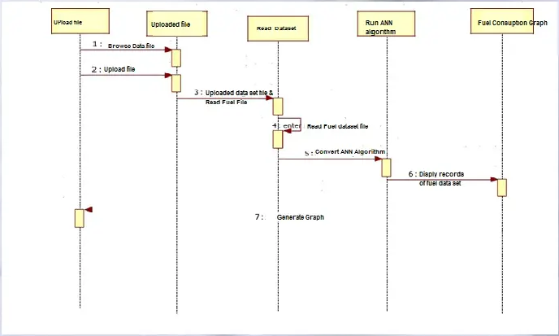
BLOCK DIAGRAM

Slide 9
SCOPE
Model that can be easily developed for individual heavy vehicles in a large fleet is proposed. Relying on accurate models of all of the vehicles in a fleet, a fleet manager can optimize the route planning for all of the vehicles based on each unique vehicle predicted fuel consumption thereby ensuring the route assignments are aligned to minimize overall fleet fuel consumption.

